Slide 1
Task Manager
Using Streamlit and MySQL

Slide 2

Tech Stack Model:

Slide 3
ER Diagram
We have created ER Diagram (Class activity diagram) using Lucid Chart as shown below.

Slide 4
Work Flow:
Create:
This page is used to create tasks. The details entered on this page are Inserted into the Tasks table.
Update:
This page is used to Update tasks. The details entered on this page are updated in the Tasks table. If the given ID does not exist in the database then, it returns an error.
Delete:
This page is used to delete the task in the task table using the task_ID. If the given ID does not exist in the database then, it returns an error.
Status:
This page is used to see the status of the task using the multiple joins of the tables: Tasks, Task_Statuses, Task_Priority, Projects, Team_Projects, Teams, Task_Assignees, Users.
Create Task
Task Status
Update Task
Task Status
Delete Task
Task Status

Slide 5
Demo:

Slide 6
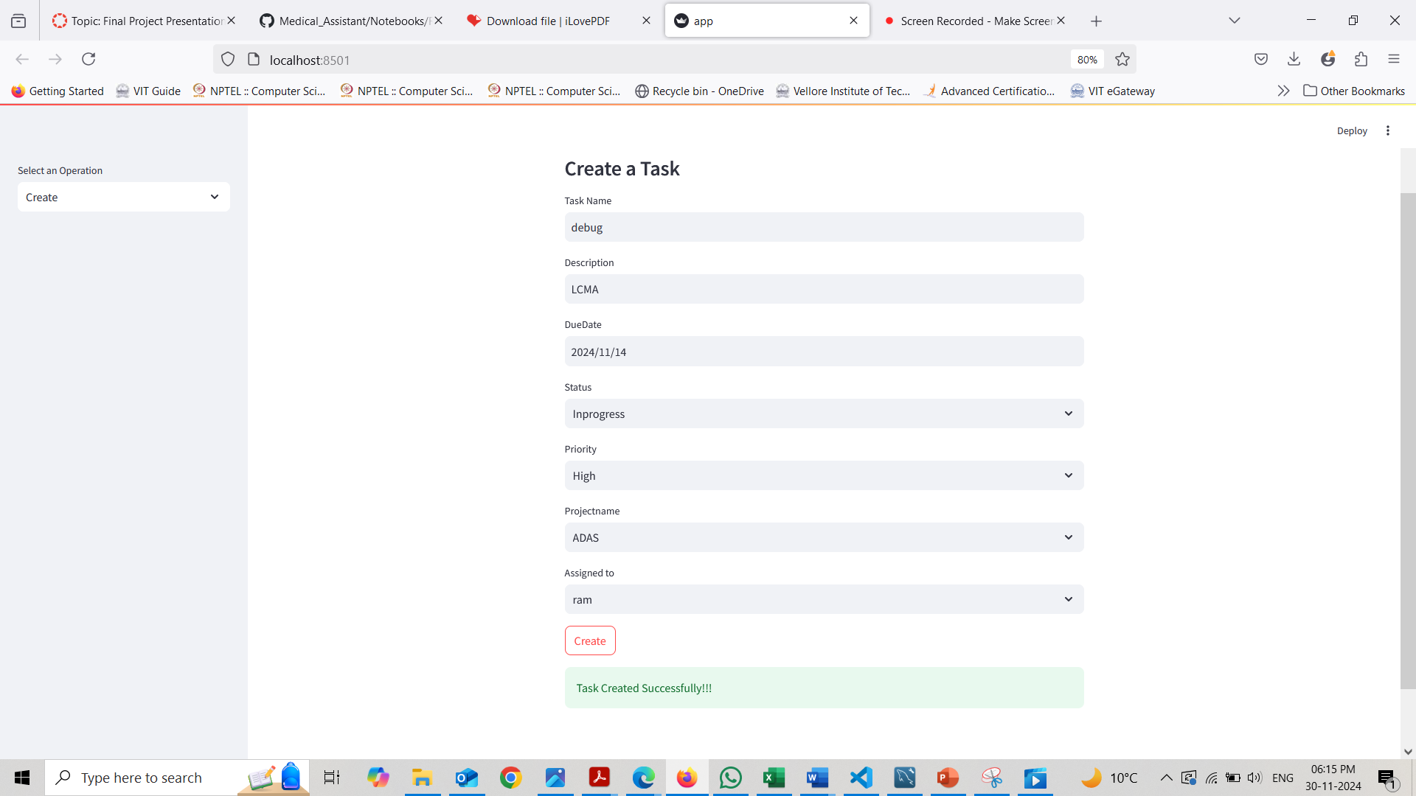
Task Creation:

Slide 7
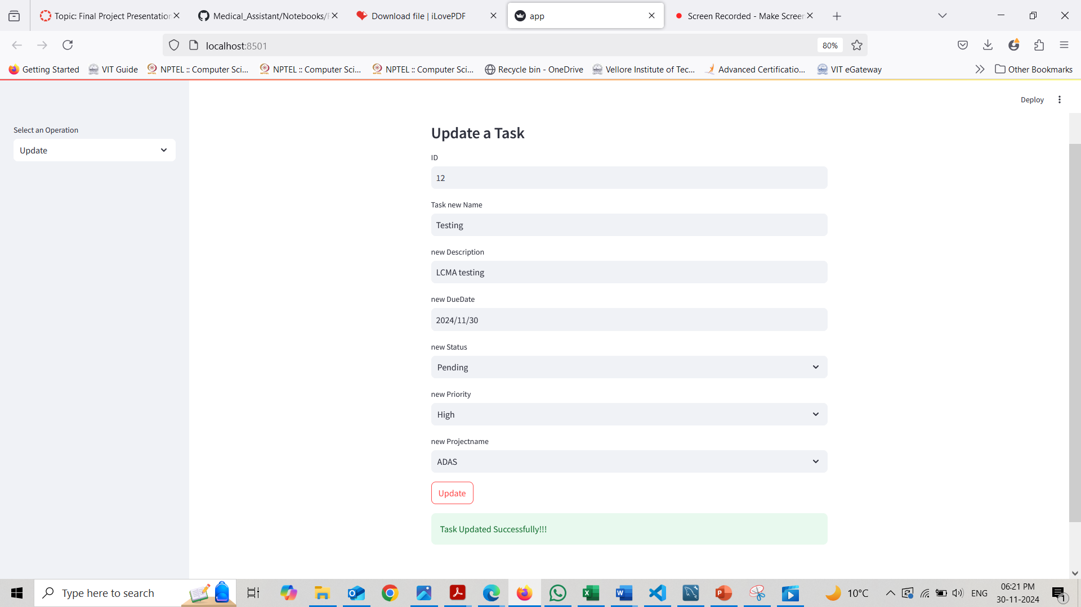
Task Update:

Slide 8
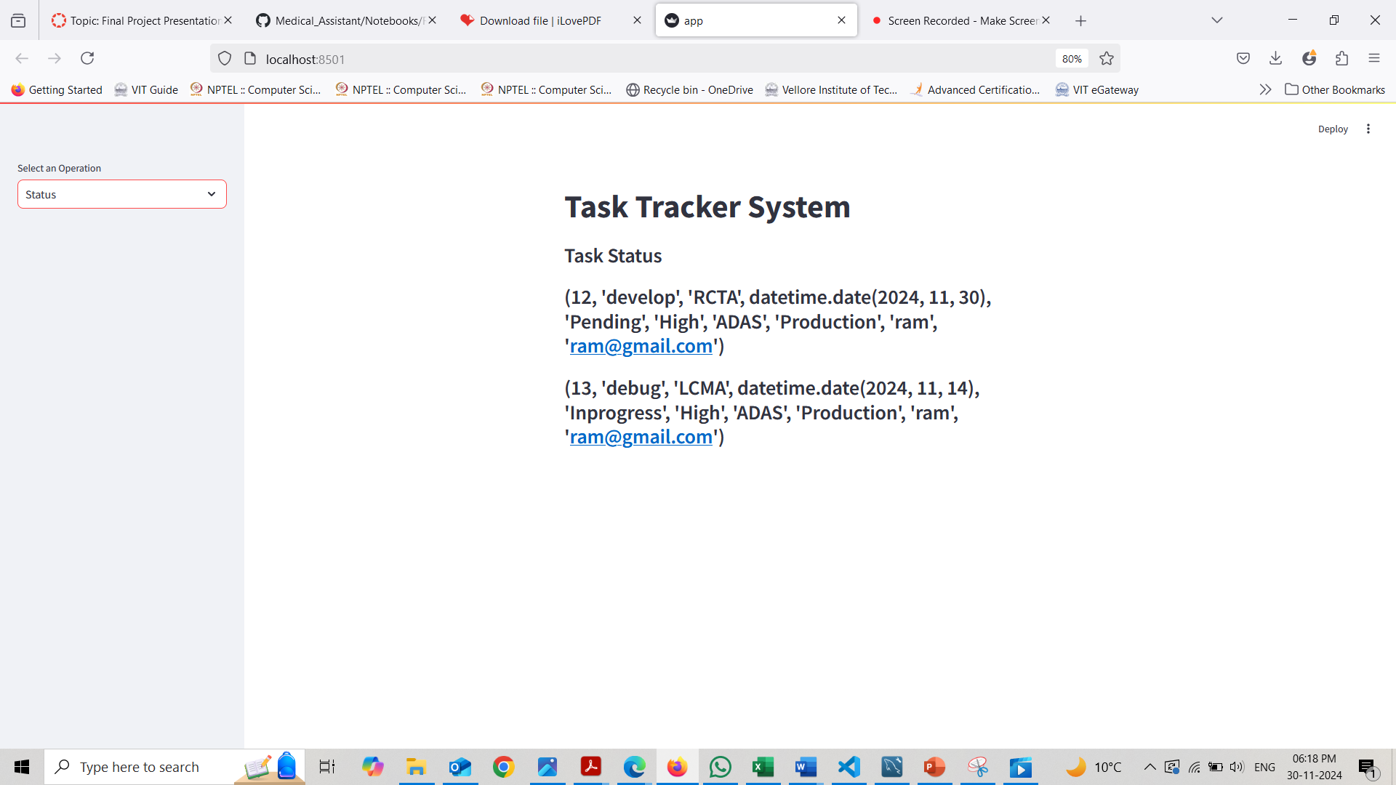
Task Status:

Slide 9
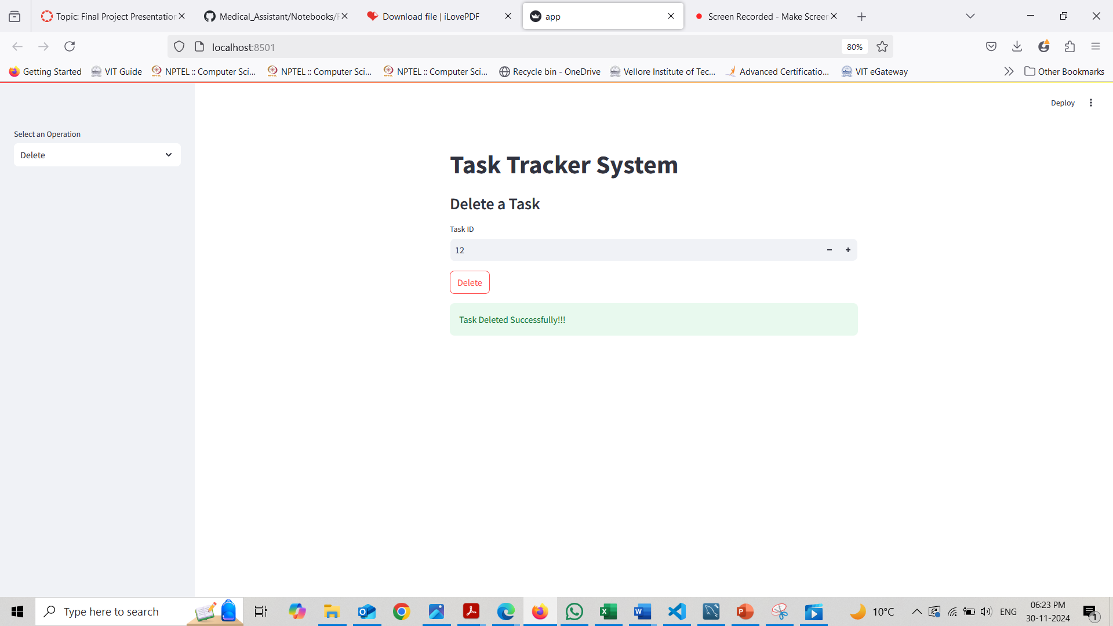
Delete Task:

